Slide 1
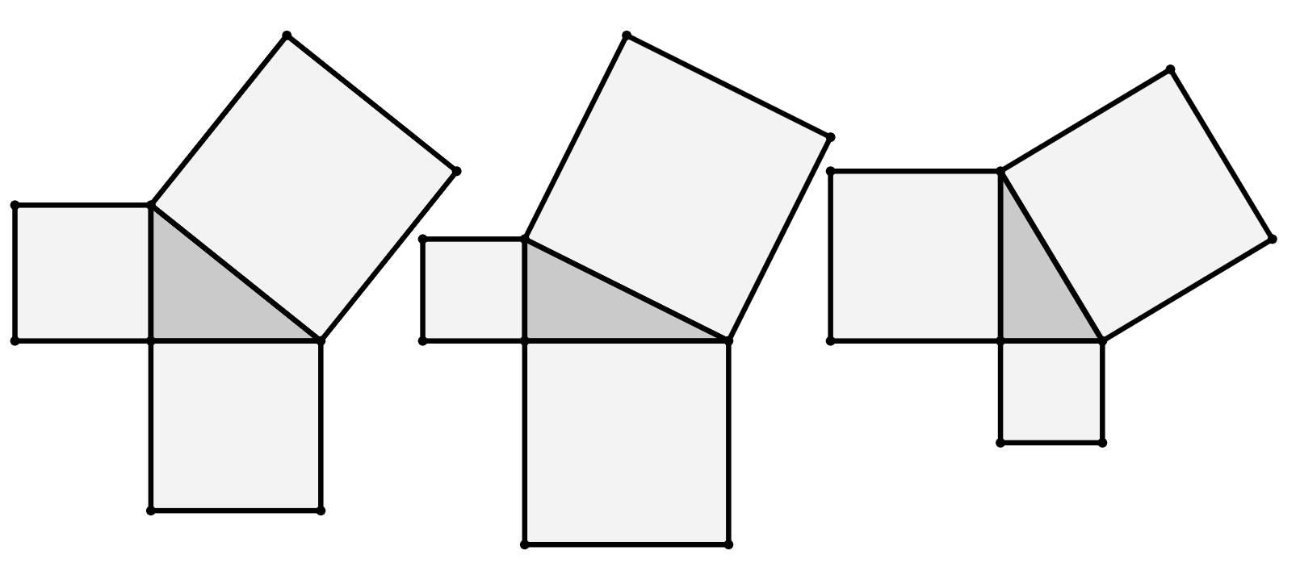
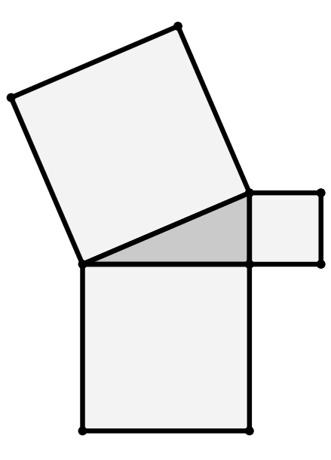
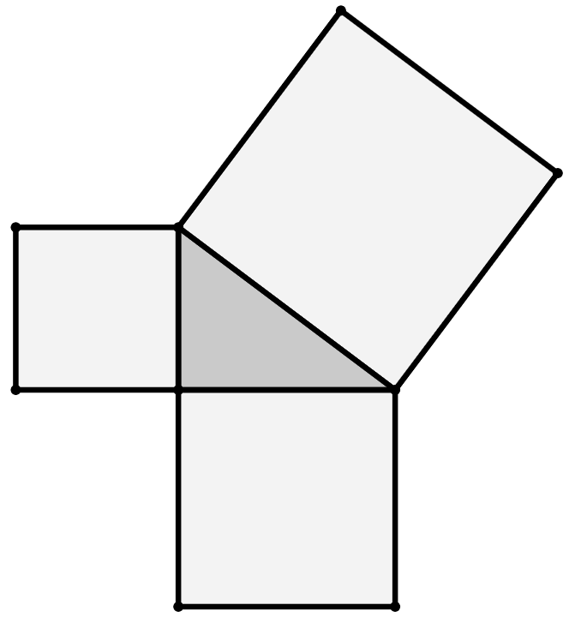
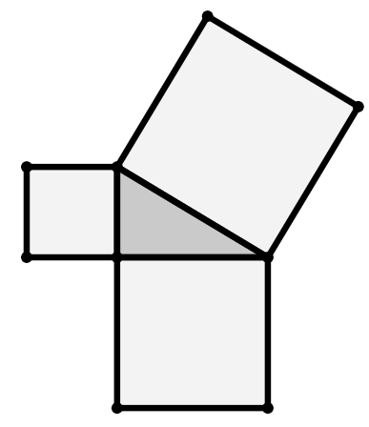
Length of the hypotenuse
Task A: Squares from the sides of a triangle
1) Find the area of each square.
a)
b)
c)
72 cm²
51 cm²
10 cm²
area
30 cm²
9 cm²
area
42 cm²
36 cm²
3 cm
1 cm²
area
15 cm²
6 cm
1 cm
2) Find the length of the hypotenuse of each triangle.
a)
area
144 cm²
b)
hypotenuse
13 cm
c)
area
144 cm²
area
81 cm²
hypotenuse
12 cm
area
41 cm²
9 cm
12 cm
area
100 cm²
area
225 cm²
area
169 cm²
10 cm
area
103 cm²
hypotenuse
15 cm
area
69 cm²

Slide 2
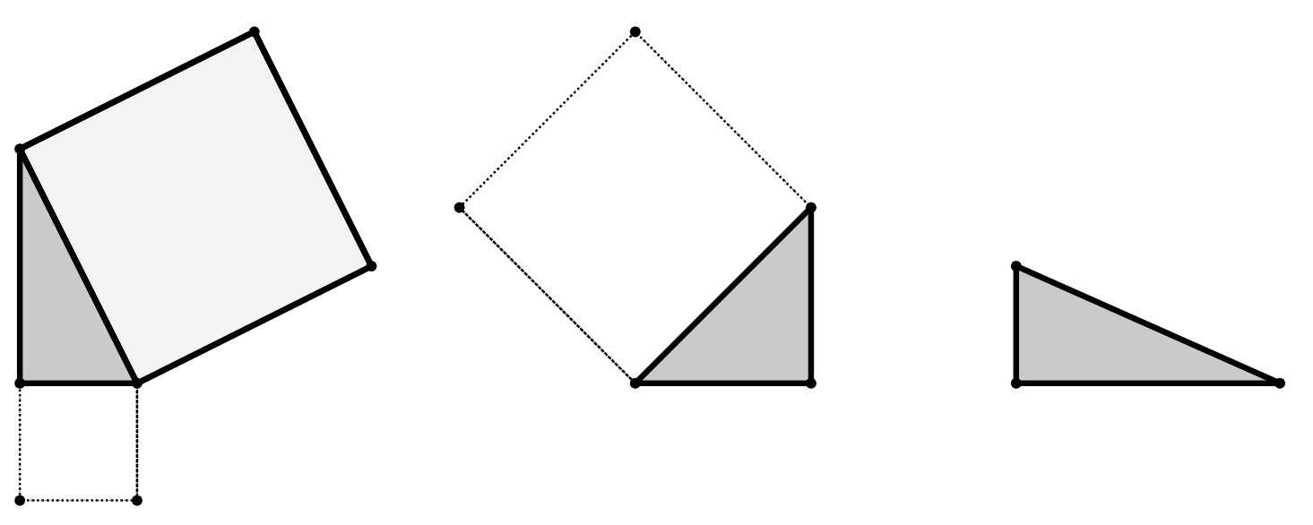

Length of the hypotenuse
3) By drawing on any missing squares first and calculating their areas, find the length of the hypotenuse of each triangle.
576 cm²
49 cm²
400 cm²
441 cm²
7 cm
a)
area
400 cm²
24 cm
20 cm
21 cm
hypotenuse
25 cm
18 cm
hypotenuse
20 cm
b)
area
841 cm²
c)
324 cm²
area 625 cm²
hypotenuse
29 cm
area
76 cm²
Task B: Pythagoras’ theorem to find the hypotenuse
1) This is a right-angled triangle.
Pythagoras’ theorem can be written as c² = a² + b², where c is the hypotenuse of the triangle.
Fill in the blanks to complete the Pythagoras’ theorem equation for this triangle.
2
2
2
61 cm
61
=
60
+
11
11 cm
or
60 cm
61
2
=
11
2
+
60
2
2) Show that the hypotenuse of this triangle is 17.2 cm (1 d.p.)
hypotenuse
10
2
+
14
2
= 296
10 cm
14 cm
296 = 2 74 = 17.20465…
hypotenuse = 17.2 cm

Slide 3
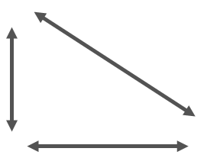
Length of the hypotenuse
3) Match each triangle to its corresponding square of the hypotenuse and length of the hypotenuse.
a)
b)
5 cm
c)
12.2 cm
11 cm
2 cm
7 cm
13 cm
10 cm
12.1 cm
149 cm²
173 cm²
f
146 cm²
e
d
i
h
g
12.1 cm
13.2 cm
12.2 cm
4) All these triangles have two lengths that sum to 64 cm.
Starting with the shortest, put the hypotenuses of the triangles in order of length.
a)
hypotenuse w
hypotenuse w = 45.25 cm
32 cm
32 cm
b)
The correct order was
w → x → y → z
The bigger the difference between the two shorter side lengths, the larger the hypotenuse became.
hypotenuse x
hypotenuse x = 45.61 cm
28 cm
36 cm
c)
43 cm
21 cm
hypotenuse y = 47.85 cm
hypotenuse y
d)
hypotenuse z
hypotenuse z = 54.92 cm
54 cm
10 cm
Mathematics in Education and Industry.

